Slide 1





DCAI - 2012
Modeling a Mobile Robot using a Grammatical Model.
Authors:
Gabriel López García
Javier Gallego Sánchez
J.Luis Dalmau Espert
Rafael Molina Carmona
Patricia Compañ Rosique

Slide 2
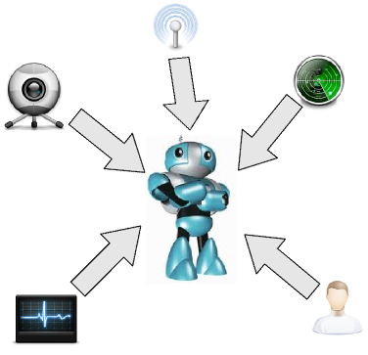


Introduction
Growing disparity of available sensors
More complexity,
but more accurate
Need integrate multiple information sense and complexity

Slide 3


Objectives
Integrate multimodal input and data of different nature
Use a grammatical model
Grammar definition integrate activities, visualization and interaction with user

Slide 4


VWG* Elements
Primitive ( P )
Primitives describe objects
Transformation ( T )
Transformations change the behaviour of primitives
*VWG = Virtual World Generator

Slide 5


VWG Elements
Actors ( )
Actors define system's activities in the virtual world
Events
Events cause the activation of a certain activity

Slide 6
Grammar
Rule 1.
WORLD → OBJECTS
Rule 2.
OBJECTS → OBJECT | OBJECT · OBJECTS
Rule 3.
OBJECT → FIGURE | TRANFORM | ACTOR
Rule 4.
ACTOR →
Rule 5.
TRANSFORM → t(OBJECTS)
Rule 6.
FIGURE → p⁺

Slide 7




Semantic Functions
Rule 6
Figures
Rule 5 Transformations
The scope is limited by '()' symbols
Sequence of primitives
G:

Slide 8
Semantic Functions
Visualization Function
It is the function that draws a set of primitives and transformations to be displayed on a geometry

Slide 9
Semantic Functions
Rule 4 - Actors
The evolution function is responsible for the activity of system

Slide 10

Semantic Functions
Evolution Function
It is the function that makes the system evolve

Slide 11
Semantic Functions
Rule 4 - Actors
The visualization function is responsible for translating actors into primitives and transformations

Slide 12

Semantic Functions
The visualization function of the system
It is the function that translates every actors into primitives and transformations

Slide 13
Semantic Functions
World
Rule 3,2,1
Objects
These rules break down the strings and convert them into substrings
Actors
Transfor.
Primit.

Slide 14



Event Generators
Events are the mechanism to model activity in the system
The event generator is a function to generate events from different devices

Slide 15
Algorithm
e*
GMV
wo
w
wsig
e^{h}
w
v
e^{v}

Slide 16


Case study

Slide 17
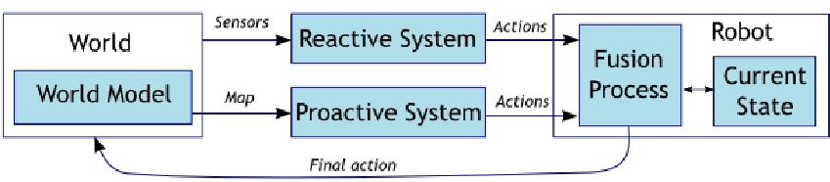
Case study
This kind of system can be modeled by an hybrid scheme that can be adapted using VWG

Slide 18
Case study
Simulator
Real
We can execute the same string into a simulator environment or a real robot

Slide 19
Case study
PRobot
Draw the robot in the GS
No action
Move a distance 'dist' in the GS
Move a distance 'dist'
TMove<dist>
TRotate<angle>
Rotate an angle 'angle' in GS.
Rotate an angle 'angle'

Slide 20


Case study
Events
gCamera
when a marker is detected
gLaser
when the laser detects an obstacle
gObjetive
when the user sets an objective
gDecide
when the robot decides an action
gExecute
when the robot executes an action

Slide 21
Case study
Evolution function

Slide 22
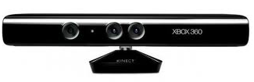
Analysis
Introduce new AI algorithm
Change or increment new devices
Multi-robot system

Slide 23
Conclusion
The new model defines a virtual world, independently from the underlying physical layer
The model allows an abstract representation
It can change, simulate or add new devices

Slide 24
DCAI - 2012
Modeling a Mobile Robot using a Grammatical Model.
Authors:
Gabriel López García
Javier Gallego Sánchez
J.Luis Dalmau Espert
Rafael Molina Carmona
Patricia Compañ Rosique

